Slide 1
CS6611 CREATIVE AND INNOVATIVE PROJECT
MADRAS INSTITUTE OF TECHNOLOGY
DEPARTMENT OF COMPUTER TECHNOLOGY
TITLE : CropForEst - A Machine learning based crop yield estimation and profitability analysis for precision agriculture.
SUNDARAJAN R B / 2020503549
HAMILTON SAMIC S / 2020503511
SURIYAA V / 2020503550
MENTOR : Dr. C. Valliyammai

Slide 2

DOMAIN
Machine Learning
Deep Learning

Slide 3
PROBLEM STATEMENT
The agriculture industry faces a significant challenge in predicting crop yield production and crop demand accurately. The traditional methods of predicting crop yield and demand are time-consuming and can be prone to errors, leading to inefficient use of resources and revenue loss. There is a need for predicting the most suitable crop based on various influential factors and forecasting the profitability.

Slide 4
OBJECTIVES
To develop an intelligent platform that uses machine learning algorithms to estimate the most suitable crop for cultivation in a given area based on environmental factors.
To forecast market demand and pricing trends for the identified crop, with the aim of increasing profitability for farmers and stakeholders in the agriculture industry.

Slide 5
LITERATURE REVIEW
Publication | Methodology | Outcome
Crop Yield Prediction Using Deep Reinforcement Learning Model for Sustainable Agrarian Applications Authors: D. Elavarasan and P. M. D. Vincent Journal: IEEE Access, vol. 8, pp. 86886-86901, 2020 | An RNN-based feature processing is combined with Deep Recurrent Q-Network model based self-experimental analysis is constructed to forecast the crop yield. Forecast is done based on major climatic factors, soil parameters. dataset extracted from Indian Meteorological department’s portal. | The results of DRQN model were compared with other ANN, BAN models using certain evaluation metrics like error, variance score and it’s outperformed all of them with 94% accuracy. The probability density of actual and predicted yield were also measured.
Estimation of crop yield from combined optical and SAR imagery using gaussian kernel regression Authors: Alebele, Yeshanbele and Wang, Wenhui and Yu, Weiguo and Zhang, Xue and Yao, Xia and Tian, Yongchao and Zhu, Yan and Cao, Weixing and Cheng, Tao Journal: IEEE Journal of Selected Topics in Applied Earth Observations and Remote Sensing | Estimation methods selected based on the tradeoff between the performance in terms of given target parameters, interpretability of results, and computational time. Multiple linear regression, random forest, and neural network are mostly used | Using Gaussian Linear regression model , a range of crop yield predicted from an unknown distribution. GPR attempts to approximate the target output f(x) where by interpreting it as a probability distribution function.

Slide 6
Publication | Methodology | Outcome
Improvised Extreme Learning Machine for Crop prediction. Authors: S. Vashisht, P. Kumar and M. C. Trivedi Journal: 2022 3rd International Conference on Intelligent Engineering and Management (ICIEM), London, United Kingdom, 2022 | The proposed approach uses a two stage process to predict crop yield. First stage - PSO algorithm is used to optimize the input weights and biases of the EML algorithm, which is a type of feedforward network with a single hidden layer. Second stage - Optimised EML model is used to predict the crop yield based on the input features. | This technique has been found to outperform traditional methods of crop yield prediction that use only one or two spectral bands resulting in improved accuracy of crop yield
Agricultural Monitoring, an Automatic Procedure for Crop Mapping and Yield Estimation: The Great Rift Valley of Kenya Case Authors: R. Luciani, G. Laneve and M. J Journal: IEEE Journal of Selected Topics in Applied Earth Observations and Remote Sensing, vol. 12, no. 7, pp. 2196-2208, July 2019, | Satellite images to extract spectral information and vegetation indices for crop classification. Random Forest (RF) and Support Vector Machines (SVM) classifiers used to classify the crops and estimate their yield. | Accurate and efficient crop monitoring and yield estimation, which can aid in decision-making for agricultural practices and food security in the Great Rift Valley and other regions with similar characteristics.

Slide 7
Publication | Methodology | Outcome
Multispectral Crop Yield Prediction Using 3D-Convolutional Neural Networks and Attention Convolutional LSTM Approaches Authors: S. M. M. Nejad, D. Abbasi-Moghadam, A. Sharifi, N. Farmonov, K. Amankulova and M. Lászlź Journal: IEEE Journal of Selected Topics in Applied Earth Observations and Remote Sensing, vol. 16 | The method involves the use of 3D-CNNs to extract features. The 3D-CNNs are used to extract features from the multispectral images, which are then fed into the AC-LSTM. The AC-LSTM captures the temporal dependencies in the data by using attention mechanisms to weight the input at each time step. | This technique has been found to outperform traditional methods of crop yield prediction that use only one or two spectral bands. Potential to improve the accuracy of crop yield prediction.
Exploiting Hierarchical Features for Crop Yield Prediction Based on 3-D Convolutional Neural Networks and Multikernel Gaussian Process Authors: M. Qiao et al. Journal: IEEE Journal of Selected Topics in Applied Earth Observations and Remote Sensing, vol. 14 | The proposed approach uses 3D-Convolutional Neural Networks (CNNs) to extract hierarchical features. Then a Multikernel Gaussian Process (MKGP) which is a non- parametric regression is used to model it. R-squared value of 0.7 is achieved, indicating a strong correlation between the predicted and actual crop yield. | The approach effectively captures the complex relationships between the multispectral data and the crop yield, leading to accurate and efficient crop yield prediction. The method can aid in decision-making for agricultural practices and food security.

Slide 8
Publication | Methodology | Outcome
Crop yield estimation at field scales by assimilating time series of sentinel-2 data into a modified CASA-WOFOST Coupled model Authors: F. Ji, J. Meng, Z. Cheng, H. Fang and Y. Wang Journal: IEEE Transactions on Geoscience and Remote Sensing, vol. 60 | A coupled CASA-WOFOST integrated model is proposed to improve the precision, reliability and stability of crop yield estimation. Ensemble Kalman Filter (EnKF) is used for data assimilation in 2 steps : forecasting and updating. R², RMSE, NRMSE, NSE, absolute error and relative error results to evaluate the performance of the models in yield simulation. | The coupled model was better than the individual CASA and WOFOST models based on almost all evaluation metrics.
Prediction of land suitability for crop cultivation based on soil and environmental characteristics using modified recursive feature elimination technique with various classifiers. Authors: G. Mariammal, A. Suruliandi, S. P. Raja and E. Poongothai Journal: IEEE Transactions on Computational Social Systems, vol. 8 | A new mode of feature selection : Modified recursive feature elimination is proposed which helps to select and rank features while the bagging technique helps accurately predict a suitable crop for the given conditions. Performance is evaluated using precision metrics like accuracy, F1 score, etc. and the dataset containing the soil and environmental features is preprocessed to remove redundant data. | Training samples are trained with the classifier and unknown samples provided to validate the trained classifier. A major breakthrough in the algorithm is the recursive feature used to eliminate the redundant fields in the dataset.

Slide 9
Publication | Methodology | Outcome
FarmEasy: An Intelligent Platform to Empower Crops Prediction and Crops Marketing Authors: Ishak, Md and Rahaman, Md Shahidur and Mahmud, Tahasin Journal: 2021 13th International Conference on Information & Communication Technology and System (ICTS) | A platform called FarmEasy that uses ML algorithms to predict crop yields, prices and provide weekly guidelines to farmers about all processes involved. The platform uses real-time data such as satellite images, weather forecasts and market prices, to train and optimize the machine learning models. Using Random Forest and Support Vector Regression as base, a new ‘Voting Regression’ model is proposed for prediction. | This helps farmers make informed decisions about when to plant, harvest and sell their crops and help distributors make better decisions about which crops to buy and sell. The authors reported promising results, demonstrating the potential of the platform to improve crop management and marketing.
Demand Prediction model for forecasting the AGRI needs of the society. Authors: Prabhu, B V Balaji and Dakshayini, M Journal: 2017 International Conference on Inventive Computing and Informatics (ICICI) | Combination of two techniques are used, Artificial Neural Networks (ANN) and Multiple Regression Analysis (MRA). The model considers factors such as population, rainfall and temperature to predict the demand for agricultural products. It is implemented using the integrated R-Hadoop machine learning model and Map-Reduce framework. | The proposed model was tested using real-time data from the Indian agricultural sector. The results show that the model has a high prediction accuracy, with a mean absolute percentage error of 2.69% for the year 2016-17.

Slide 10
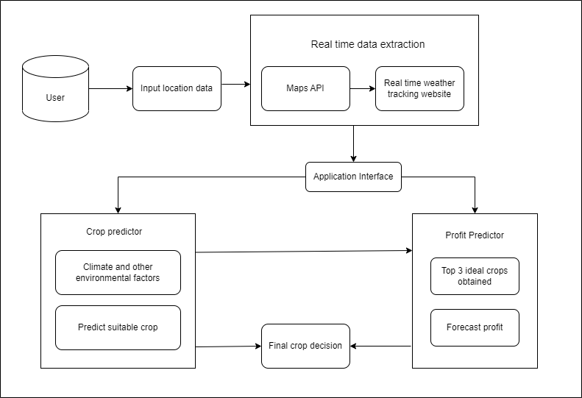
ARCHITECTURAL DIAGRAM

Slide 11
MODULES
Data pre-processing
Model selection
Model integration
Model training
Application interface development

Slide 12
DATASETS
https://www.kaggle.com/datasets/atharvaingle/crop-recommendation-dataset - set of recommended crop with factors.
https://www.kaggle.com/datasets/nikhilmahajan29/crop-production-statistics-india - corresponding crops for the particular district and states.
https://www.kaggle.com/datasets/prasanshasatpathy/soil-types - set of soil types
https://www.kaggle.com/datasets/syedjaferk/crops-arrivalprice-dataset-india-344-crops - crop prices with corresponding demand and supply.
ATTRIBUTES
NPK ratios, Temperature, humidity, pH, rainfall, State, Soil type, District, Markets, Year, Seasons, Yield , Crop name, Modal price

Slide 13
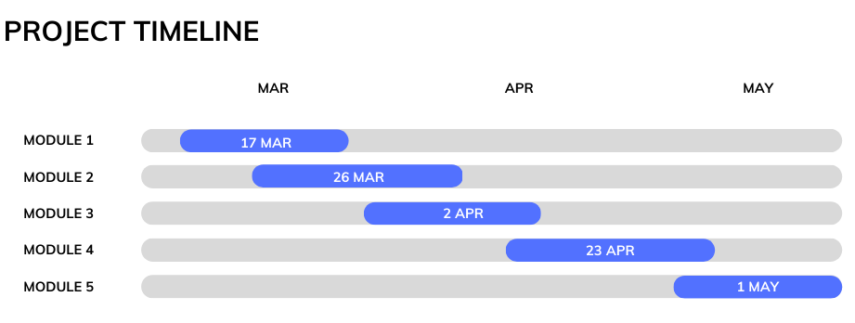

Slide 14
REFERENCES
D. Elavarasan and P. M. D. Vincent, "Crop Yield Prediction Using Deep Reinforcement Learning Model for Sustainable Agrarian Applications," in IEEE Access, vol. 8, pp. 86886-86901, 2020, doi: 10.1109/ACCESS.2020.2992480.
Y. Alebele et al., "Estimation of Crop Yield From Combined Optical and SAR Imagery Using Gaussian Kernel Regression," in IEEE Journal of Selected Topics in Applied Earth Observations and Remote Sensing, vol. 14, pp. 10520-10534, 2021, doi: 10.1109/JSTARS.2021.3118707.
S. Vashisht, P. Kumar and M. C. Trivedi, "Improvised Extreme Learning Machine for Crop Yield Prediction," 2022 3rd International Conference on Intelligent Engineering and Management (ICIEM), London, United Kingdom, 2022, pp. 754-757, doi: 10.1109/ICIEM54221.2022.9853054.
R. Luciani, G. Laneve and M. JahJah, "Agricultural Monitoring, an Automatic Procedure for Crop Mapping and Yield Estimation: The Great Rift Valley of Kenya Case," in IEEE Journal of Selected Topics in Applied Earth Observations and Remote Sensing, vol. 12, no. 7, pp. 2196-2208, July 2019, doi: 10.1109/JSTARS.2019.2921437.
S. M. M. Nejad, D. Abbasi-Moghadam, A. Sharifi, N. Farmonov, K. Amankulova and M. Lászlź, "Multispectral Crop Yield Prediction Using 3D-Convolutional Neural Networks and Attention Convolutional LSTM Approaches," in IEEE Journal of Selected Topics in Applied Earth Observations and Remote Sensing, vol. 16, pp. 254-266, 2023, doi: 10.1109/JSTARS.2022.3223423.
M. Qiao et al., "Exploiting Hierarchical Features for Crop Yield Prediction Based on 3-D Convolutional Neural Networks and Multikernel Gaussian Process," in IEEE Journal of Selected Topics in Applied Earth Observations and Remote Sensing, vol. 14, pp. 4476-4489, 2021, doi: 10.1109/JSTARS.2021.3073149.
F. Ji, J. Meng, Z. Cheng, H. Fang and Y. Wang, "Crop Yield Estimation at Field Scales by Assimilating Time Series of Sentinel-2 Data Into a Modified CASA-WOFOST Coupled Model," in IEEE Transactions on Geoscience and Remote Sensing, vol. 60, pp. 1-14, 2022, Art no. 4400914, doi: 10.1109/TGRS.2020.3047102.
G. Mariammal, A. Suruliandi, S. P. Raja and E. Poongothai, "Prediction of Land Suitability for Crop Cultivation Based on Soil and Environmental Characteristics Using Modified Recursive Feature Elimination Technique With Various Classifiers," in IEEE Transactions on Computational Social Systems, vol. 8, no. 5, pp. 1132-1142, Oct. 2021, doi: 10.1109/TCSS.2021.3074534.
M. Ishak, M. S. Rahaman and T. Mahmud, "FarmEasy: An Intelligent Platform to Empower Crops Prediction and Crops Marketing," 2021 13th International Conference on Information & Communication Technology and System (ICTS), Surabaya, Indonesia, 2021, pp. 224-229, doi: 10.1109/ICTS52701.2021.9608436.
B. V. B. Prabhu and M. Dakshayini, "Demand-prediction model for forecasting AGRI-needs of the society," 2017 International Conference on Inventive Computing and Informatics (ICICI), Coimbatore, India, 2017, pp. 430-435, doi: 10.1109/ICICI.2017.8365388.

